Slide 1
Chapter 8 (DC)
Methods of Analysis
And Selected Topics
1

Slide 2
8.9 NODAL ANALYSIS
Steps of Nodal Analysis:
Convert voltage sources to current sources.
Determine the number of nodes within the network.
2. Pick a reference node, and label each remaining node with a subscripted value
of voltage: V₁, V₂, and so on.
3. Apply Kirchhoff’s current law (KCL) at each node except the reference. Assume that:
(a) all unknown currents leave the node for each application of Kirchhoff’s
current law (KCL).
(b) Each node is to be treated as a separate entity, independent of the
application of KCL to the other nodes.
4. Solve the resulting equations for the nodal voltages.
2

Slide 3
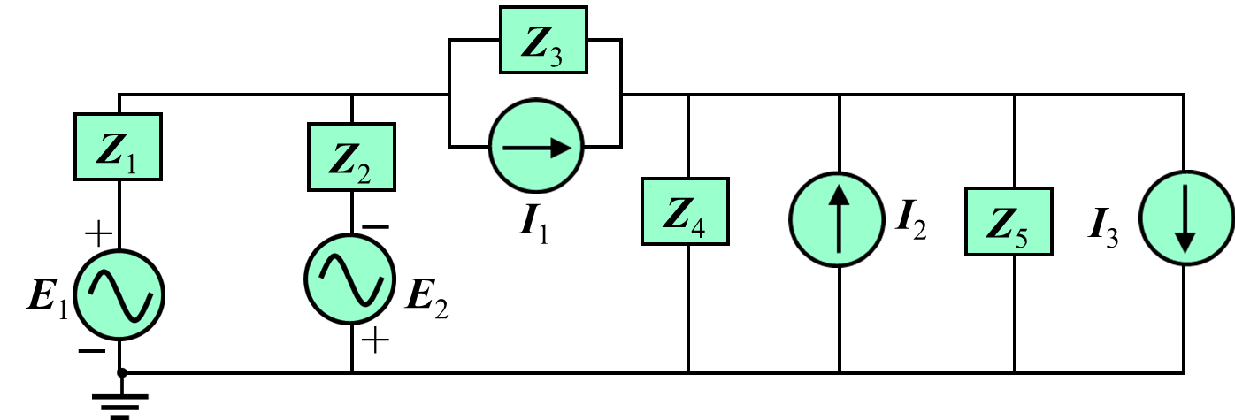
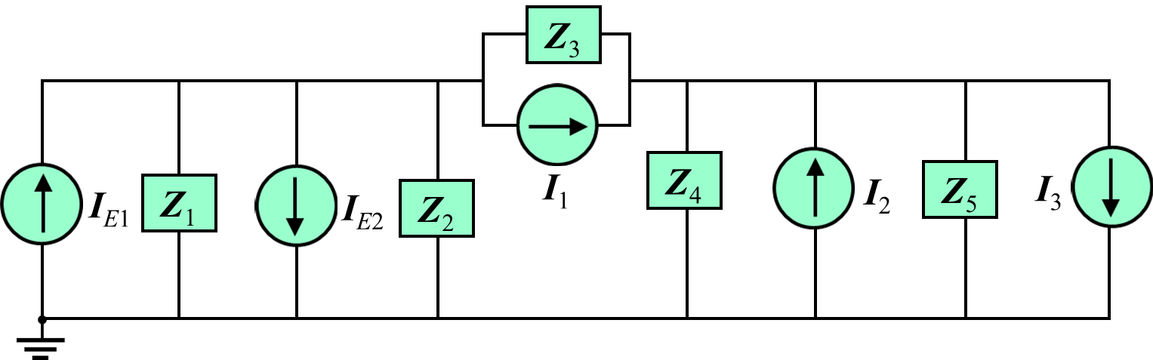
Developed Nodal Equations for the Following Circuit:
Step 1: Convert voltage sources to current sources.
Here:
3

Slide 4
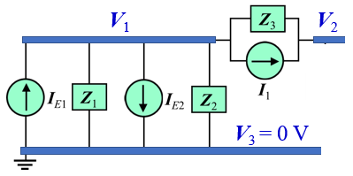
Step 2 and Step 3:
V₁
V₂
Consider node 3 as a reference i.e.
V₃ = 0 V
V₃ = 0 V
Consider node V₁:
Write the Nodal Equation by Applying Kirchhoff’s current law (KCL):
Assume all unknown currents leave the node
I_{Z3}
I_{Z1}
I_{Z2}
4

Slide 5
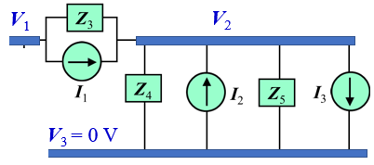
Consider node V₂:
Write the Nodal Equation by Applying Kirchhoff’s current law (KCL):
Assume all unknown currents leave the node
I_{Z3}
I_{Z4}
I_{Z5}
Nodal equations in matrix form as follows:
5

Slide 6
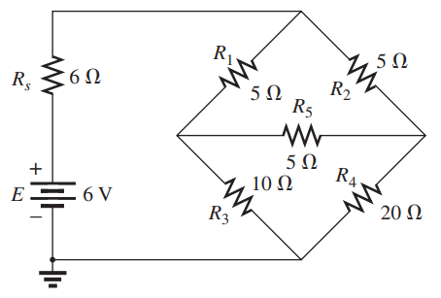
Write the nodal equations for the following networks.
V₁
V₂
V₃
6

Slide 7
Example
NODAL ANALYSIS [DC]
7

Slide 8
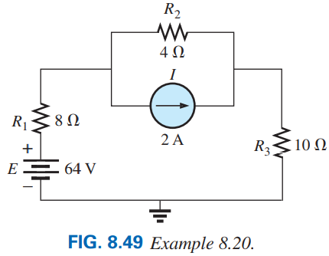
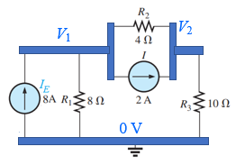
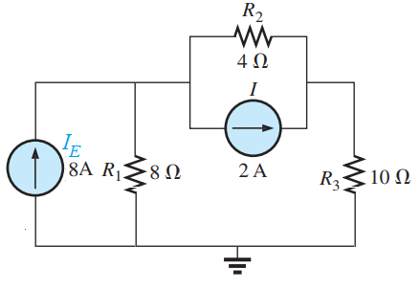
EXAMPLE 8.20 Apply nodal analysis to the network in Fig. 8.49.
Step 1 and 2: The network has three nodes with the bottom node defined as the reference node (at ground potential, or zero volts), and the other nodes as V₁ and V₂.
Step 3: For node V₁, the currents are defined as shown in the following Figure (b) and Kirchhoff’s current law is applied:
I₂
Solution: Convert the voltage sources to current sources as shown in Figure (a).
I₁
V₁
V₂
(b)
0 V
(a)
8

Slide 9
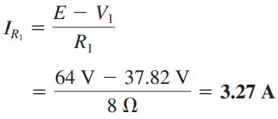
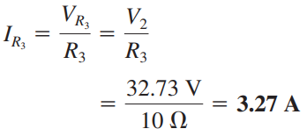
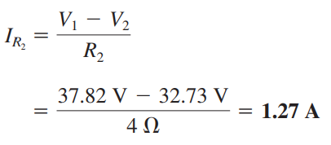
For node V₂, the currents are defined as shown in the following Figure (c) and Kirchhoff’s current law is applied:
I₂
I₃
(c)
9

Slide 10
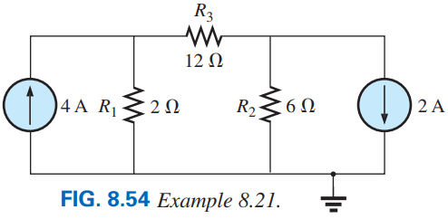
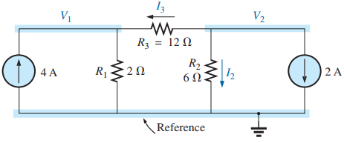
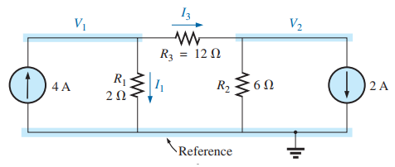
Step 3: For node V₁, the currents are defined as shown in the following Figure (a) and Kirchhoff’s current law is applied:
For node V₂, the currents are defined as shown in the following Figure (b) and Kirchhoff’s current law is applied:
Step 1 and 2: The network has three nodes with the bottom node defined as the reference node (at ground potential, or zero volts), and the other nodes as V₁ and V₂.
(b)
(a)
10

Slide 11
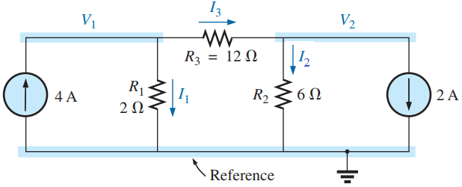



Here, V₁> V₁
11

Slide 12
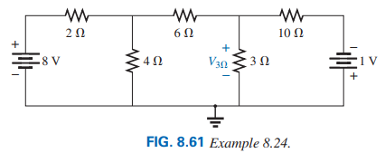
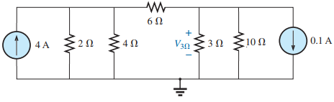
EXAMPLE 8.24 Find the voltage across the 3 Ω resistor in Fig. 8.61 by nodal analysis.
Step 3: For node V₁, the currents are defined as shown in the following Figure (b) and Kirchhoff’s current law is applied:
For node V₂:
Solution: First convert two voltage sources to current sources.
V₁
V₂
Simplified form:
Step 1 and 2: The network has three nodes with the bottom node defined as the reference node (at ground potential, or zero volts), and the other nodes as V₁ and V₂.
12

Slide 13
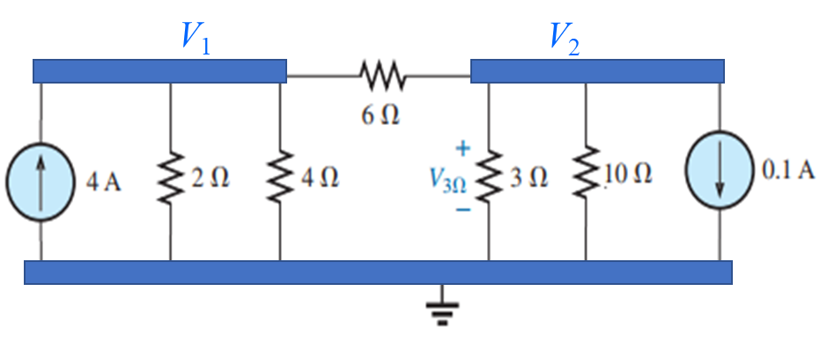
Current of branches:
13

Slide 14
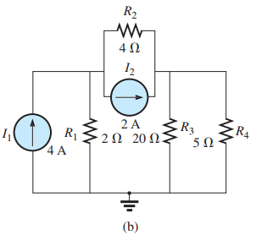
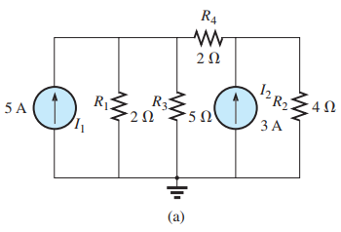
Write the nodal equations for the following networks.
V₁
V₂
V₁
V₂
14

Slide 15
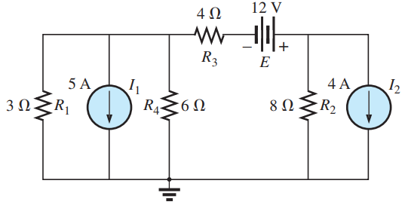
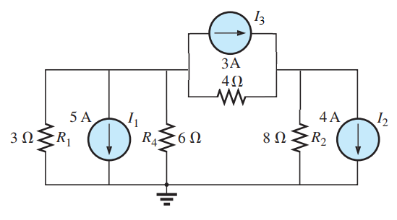
Write the nodal equations for the following networks.
V₁
V₂
15

Slide 16
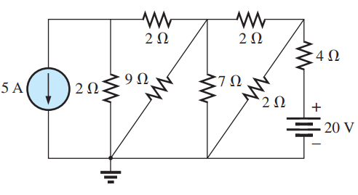
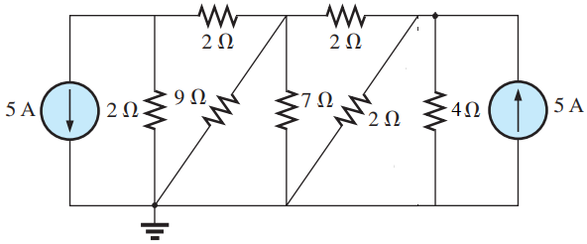
Write the nodal equations for the following networks.
V₁
V₂
V₃
Practice Book [Ch 8] Problem: 41 ~ 44
16

Slide 17
8.12 Y−Δ (T−Π) and Δ−Y (Π−T) CONVERSIONS
Circuit configurations are often encountered in which the resistors do not appear to be in series or parallel. Under these conditions, it may be necessary to convert the circuit from one form to another [i.e. convert from Y/T to Δ/Π or Δ/Π to Y/T] to solve for any unknown quantities
17

Slide 18
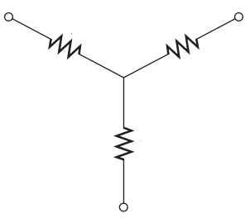
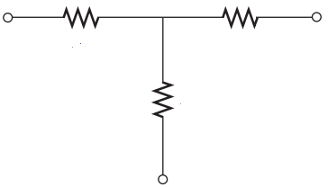
Y (Wye)
a
c
R_{c}
R_{a}
R_{b}
b
T (Tee)
a
R_{a}
R_{c}
c
R_{b}
b
18

Slide 19
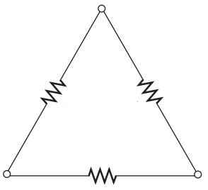
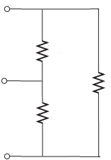
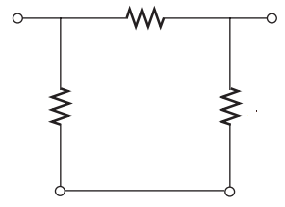
Δ (Delta)
a
a
R_{ab}
R_{ab}
R_{ca}
b
R_{ca}
R_{bc}
R_{bc}
b
c
c
Π (Pai)
a
R_{ab}
b
R_{ca}
R_{bc}
c
c
19

Slide 20
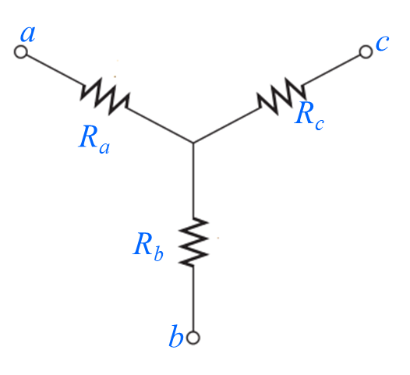
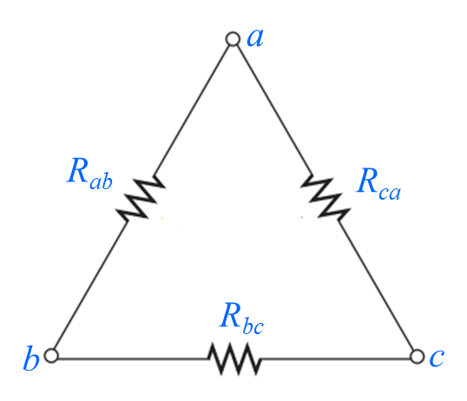
Conversion from Y (T) to Δ (Π)
Calculate R_{ab}, R_{bc} and R_{ca}
Here, R_{a}, R_{b} and R_{c} are known.
For derivation of these equations go through Eq. (8.3a) to (8.4 c)
20

Slide 21
Conversion from Δ (Π) to Y (T)
Calculate R_{a}, R_{b} and R_{c}
Here, R_{ab}, R_{bc} and R_{ca} are known.
For derivation of these equations go through Eq. (8.5a) to (8.5c)
21

Slide 22
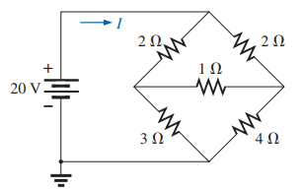
Problem 51(a) [P. 342]. Using a Δ-Y or Y-Δ conversion, find the current I in each of the networks in Fig. 8.134(a).
a
R_{ad}
R₁
d
b
R_{cd}
R_{bd}
R₂
c
Solution: First, marked four nodes (a, b, c, and d) in the circuit.
Let, R_{ad} = 2 Ω, R_{bd} = 1 Ω, R_{cd} = 3 Ω, R₁ = 2 Ω, and R₂ = 4 Ω
Here, R_{ad}, R_{bd}, and R_{cd} made Y connection where d is common point. So, this Y connection is going to convert Δ connection.
22

Slide 23


a
I
R_{ab}
3.67 Ω
R₁
2 Ω
+
R_{ca}
11 Ω
b
20 V
−
R_{bc}
5.5 Ω
R₂
4 Ω
c
23

Slide 24
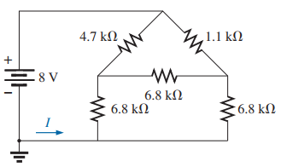
Problem 51(b) [P. 342]. Using a Δ-Y or Y-Δ conversion, find the current I in each of the networks in Fig. 8.134(b).
R₁
R₂
R_{ab}
a
b
R_{bc}
R_{ca}
c
Solution: First, marked four nodes (a, b, and c) in the circuit.
R₁
4.7 kΩ
R₂
1.1 kΩ
+
a
b
Let, R₁=4.7 kΩ, R₂=1.1 kΩ, R_{ab}=R_{bc}=R_{ca}= 6.8 kΩ
8 V
R_{a}
2.27 Ω
R_{b}
2.27 Ω
−
Here, R_{ab}, R_{bc}, and R_{ca} made Δ connection. So, this Δ connection is going to convert Y connection.
R_{c}
2.27 Ω
I
c
24

Slide 25
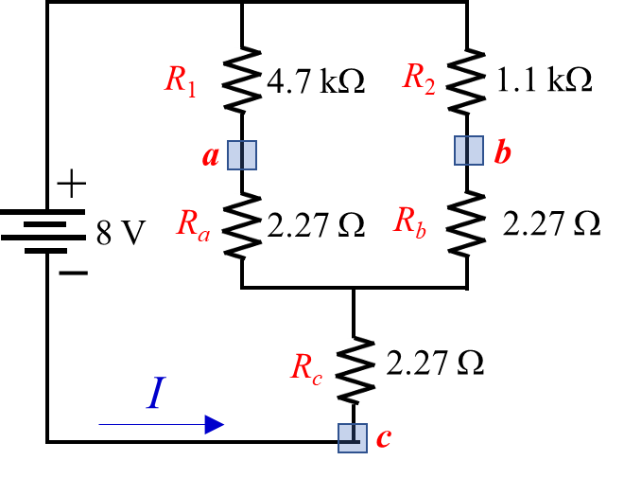
Practice Book [Ch 8] Problem: 51 ~ 56
25

Slide 26
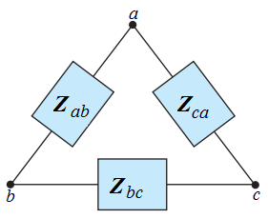
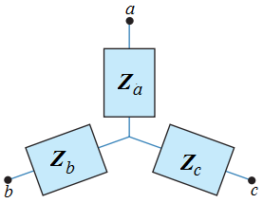
Δ (Π) to Y (T) Conversion
Y (T) to Δ (Π) Conversion
Z_{ab}, Z_{bc} and Z_{ca} are know.
Z_{a}, Z_{b} and Z_{c} are know.
26

Slide 27
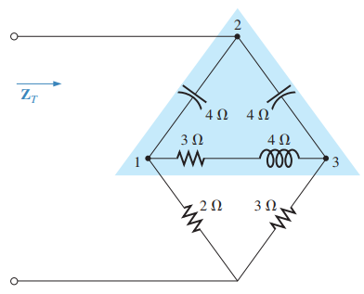
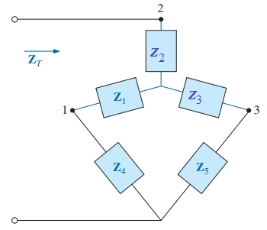
Solution:
27

Slide 28
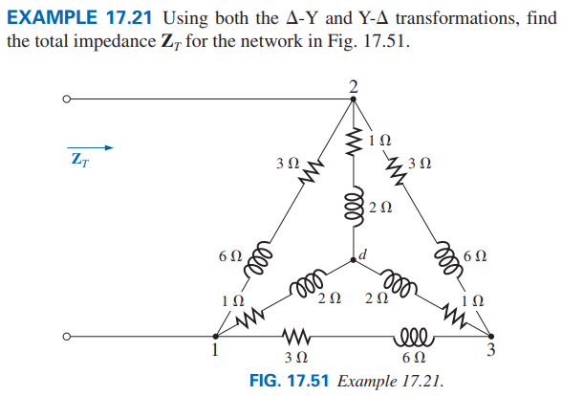
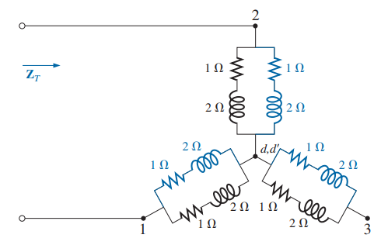

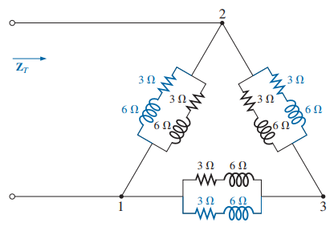
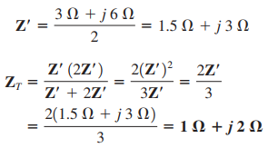
28

Slide 29
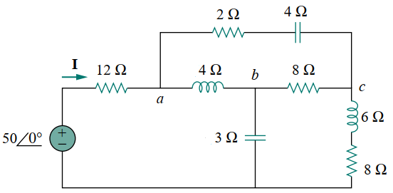
Example: Find the Current I for the following circuit.
Z_{ca}
b
Z₁
Z_{ab}
Z_{bc}
c
I
a
V
Z₂
Z₃
29

Slide 30
Z_{an}
Z_{bn}
Z_{cn}
Z₁
a
b
c
I
V
Z₂
Z₃
Z₄
I
V
Z₅
Z₆
Practice Book [Ch 17] Problem: 32 ~ 33
30

Slide 31
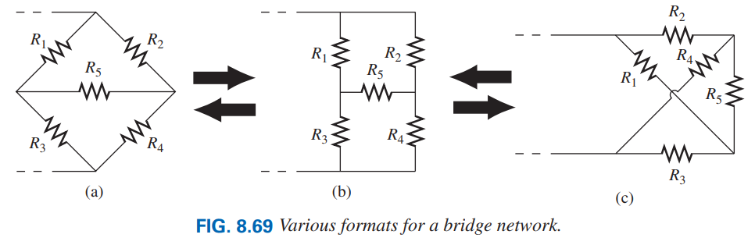
8.11 BRIDGE NETWORKS
1
1
1
4
2
4
2
4
2
3
3
3
31

Slide 32
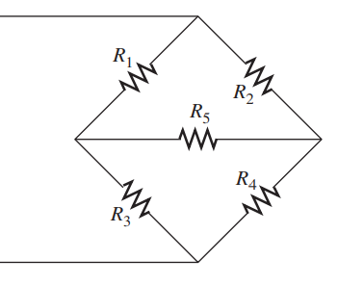
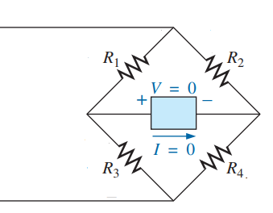
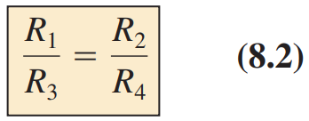
Balanced Bridge Network
If the ratio of R₁ to R₃ is equal to that of R₂ to R₄, the bridge is balanced, and I = 0 A or V = 0 V.
If this condition is not satisfied, to solve the bridge circuit use the other techniques.
32

Slide 33
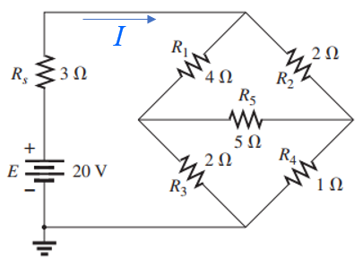
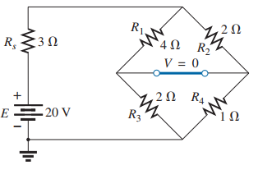
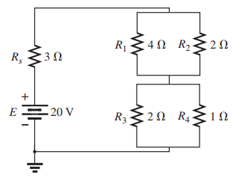


Example 8.11.1: Find the current I for the following network.
Solution: Here:
33

